Slide 1
Predicting Diabetes Onset Using ANN
PRESENTED BY:
TAMILSELVAN A
513121104043
THANTHAI PERIYAR GOVERNMENT INSTITUTE OF TECHNOLOGY, VELLORE-632002.

Slide 2
AGENDA
Problem Statement
Project Overview
End Users
Our Solution and Proposition
The Wow in Your Solution
Modeling
Results and Evaluation
Conclusion

Slide 3
Problem statement
Diabetes is a prevalent chronic disease affecting millions of people worldwide. Early detection and intervention are crucial for managing the condition effectively and preventing complications
In the context of diabetes prediction, the problem statement could be something like: “Develop a machine learning model to accurately predict diabetes onset based on a set of patient data”

Slide 4
PROJECT OVERVIEW
The project overview section likely provides a brief introduction to the project, including its goals, methodology, and expected outcomes.
1. Motivation:
Diabetes is a growing health concern worldwide, with significant health and economic consequences.
Early detection of diabetes is crucial for effective management and preventing complications.
2. Objective:
Develop a machine learning model that can analyze patient health data and predict the likelihood of developing diabetes.

Slide 5
3. Methodology:
Utilize a readily available diabetes dataset containing various patient health-related features.
Apply data preprocessing techniques to clean and prepare the data for model training.
Develop and train a neural network model using the Keras library.
Evaluate the model's performance on unseen data to assess its accuracy in predicting diabetes onset.
4. Expected Outcomes:
A well-trained machine learning model with high accuracy in predicting diabetes.
Insights into the relationship between specific health factors and diabetes risk.
Potential for early detection and improved management of diabetes.

Slide 6
END USERS
The end users section likely identifies the intended audience for the project's results.
This could include
healthcare professionals,
researchers,
patients
The code snippet you provided wouldn't be directly relevant to this section either.

Slide 7
the SOLUTION AND ITS VALUE PROPOSITION
This section likely describes the proposed solution for addressing the problem statement. In this case, the solution would be the machine learning model for diabetes prediction. The code snippet you provided demonstrates the building of such a model using a neural network approach

Slide 8
THE “WOW” IN SOLUTION
High Accuracy
Early Stage Prediction
Explainability
Transparency
Generalizability
Personalization

Slide 9
Modeling
Data Collection: Gather a dataset containing relevant information about individuals, including features like age, BMI, glucose levels, blood pressure, family history, etc., along with their corresponding diabetes status (diabetic or non-diabetic).
Data Preprocessing: This step involves cleaning the data, handling missing values, and encoding categorical variables if any. Data normalization may also be necessary to ensure that all features are on a similar scale, which helps in the training process.
Splitting the Data: Split the dataset into training and testing sets. The training set is used to train the model, while the testing set is used to evaluate its performance.
Model Architecture: Define the architecture of the ANN. This includes specifying the number of layers, the number of neurons in each layer, and the activation functions to be used. For binary classification like predicting diabetes, a simple architecture with input, hidden, and output layers suffices.
Model Training: Train the ANN using the training data. This involves feeding the input data forward through the network, computing the output, comparing it with the actual output, and adjusting the weights of the connections using backpropagation and optimization algorithms like gradient descent.

Slide 10
Model Evaluation: Evaluate the performance of the trained model using the testing dataset. Common evaluation metrics for classification tasks include accuracy, precision, recall, F1-score, and ROC-AUC.
Hyperparameter Tuning: Fine-tune the hyperparameters of the ANN, such as learning rate, number of epochs, batch size, and architecture parameters, to optimize the model's performance.
Cross-Validation (Optional): Perform cross-validation to ensure the robustness of the model by splitting the dataset into multiple subsets and training the model on different combinations of these subsets.
Deployment and Monitoring: Once satisfied with the model's performance, deploy it for real-world use. Continuously monitor the model's performance and retrain it periodically with new data to keep it up-to-date and accurate.
Interpretation and Insights: Analyze the trained model to gain insights into which features are most important for predicting diabetes. This can help in understanding the underlying factors contributing to diabetes risk and guide preventive measures

Slide 11
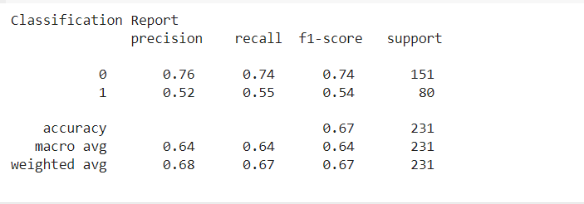
EVALUATION

Slide 12
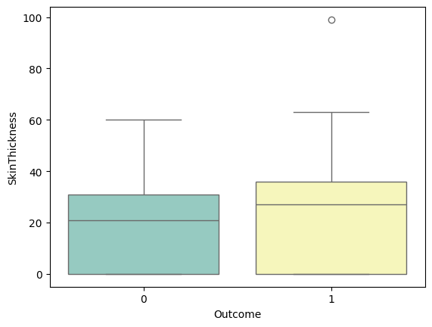
Model EVALUATION by visualisation

Slide 13
CONCLUSION
The conclusion section likely summarizes the project's findings and reiterates its significance. It might also discuss potential future work or improvements to the model. The code snippet you provided wouldn't directly contribute to this section.
In summary, the code snippet you provided focuses on the "Modeling" section of the project, which details the development of a machine learning model for diabetes prediction using a neural network approach.

Slide 14
THANK YOU

